Slide 1
INSTRUCTIONS
Use Font size 22 to 28 and Font Style Times New Roman (body)
Do not change the Template: Heading / Title of the slides
Do not change font style or colours
Do not copy paste paragraphs: use only Bullet Points
Maximum slide Limit is 20 only
As per the number of supervisor allotted adopt slide-2 or slide-3
Please display the required meaningful Content or images or tables
Change the footer accordingly using insert tab then click on header & footer tab and edit it
Save the PPT with Register No, Dept and Review no, example: 23xxxxxxxxx_CSE

Slide 2

Title: EV Charging Station Locator
Student Name: Nomula Sainath reddy
Student ID: 2520090115
Cluster:3
Section:10
Under the Guidance
of
Supervisor Name: Jayaram Boga
Assistant Professor
Department of CSE
bo

Slide 3
OUTLINE
Abstract
Existing System
Proposed System
System Architecture
Project Modules
Objectives
Co’s Attainments - FWD
Co1
Co2 …….. 5. Co5
Co’s Attainments - DSA
Co1
Co2 …….. 5. Co5
Screen Shots for FWD & DSA
Conclusion
Geo-Tagged Photos

Slide 4
Abstract
The EV Charging Station Locator is a web-based application developed using HTML and CSS to help electric vehicle (EV) users easily find nearby charging stations. With the rapid increase in the adoption of electric vehicles, the availability and accessibility of charging infrastructure have become major concerns for users. This project aims to provide a simple and organized platform where users can view information about charging stations such as location, charging type, availability status, and contact details. By presenting the information in a structured and easy-to-read format, the system reduces the difficulty faced by EV owners in locating suitable charging points.

Slide 5
Existing System
The current system for finding EV charging stations is mostly manual and inefficient. Users rely on general map services like Google Maps to search for charging stations, which often do not provide real-time availability, pricing details, or charger types. Many users face difficulties locating nearby charging stations quickly, especially when traveling in unfamiliar areas. Additionally, existing systems lack proper filtering options, booking facilities, and intelligent recommendations, which can lead to long waiting times and inconvenience for EV users.

Slide 6
Proposed System
The proposed system is a web-based EV Charging Station Locator that helps users easily find and access nearby charging stations. The system provides detailed information such as station location, charging power, price per kWh, availability status, and supported connector types. It integrates map visualization using Leaflet and applies smart filtering and recommendation features to help users choose the best station. The platform also allows users to book charging slots and view station details, making the charging process faster, easier, and more efficient.

Slide 7
System Architecture
The system follows a three-layer architecture:
1. Presentation Layer (Frontend)
Developed using HTML, CSS, and JavaScript
Provides user interface for searching stations, filtering results, and booking slots.
2. Application Layer (Logic Layer)
Handles search, filtering, sorting, and station recommendation logic.
Implements algorithms such as Dijkstra's Algorithm for route optimization.
3. Data Layer (Storage Layer)
Stores charging station data, booking details, and user preferences.
In this project, browser storage (LocalStorage) is used to simulate a database.

Slide 8
Project Modules
The system is divided into the following modules:
1. User Interface Module Provides a user-friendly interface for searching and viewing charging stations.
2. Station Locator Module Displays charging stations on the map and calculates nearby stations.
3. Filtering and Search Module Allows users to filter stations by power, price, status, and connector type.
4. Booking Module Enables users to reserve a charging slot at a selected station.
5. Admin Module Allows administrators to add or manage charging station details.

Slide 9
Objectives
The system follows a three-layer architecture:
1. Presentation Layer (Frontend)
Developed using HTML, CSS, and JavaScript
Provides user interface for searching stations, filtering results, and booking slots.
2. Application Layer (Logic Layer)
Handles search, filtering, sorting, and station recommendation logic.
Implements algorithms such as Dijkstra's Algorithm for route optimization.
3. Data Layer (Storage Layer)
Stores charging station data, booking details, and user preferences.
In this project, browser storage (LocalStorage) is used to simulate a database.

Slide 10
Co’s Attainments - FWD
• CO1: Design structured web pages using HTML/CSS → Attained • CO2: Implement dynamic behavior with JavaScript → Attained • CO3: Manage client-side data using Local Storage → Attained • CO4: Develop role-based interfaces (viewer/editor) → Attained • CO5: Handle forms, events, and real-time UI updates → Attained

Slide 11
Co’s Attainments - DSA
• CO1: Implement linear data structures (array) → Attained • CO2: Apply searching algorithms (linear search) → Attained • CO3: Use sorting techniques (bubble sort) → Attained • CO4: Demonstrate stack operations (LIFO – recent resources) → Attained • CO5: Demonstrate queue operations (FIFO – requests) → Attained

Slide 12
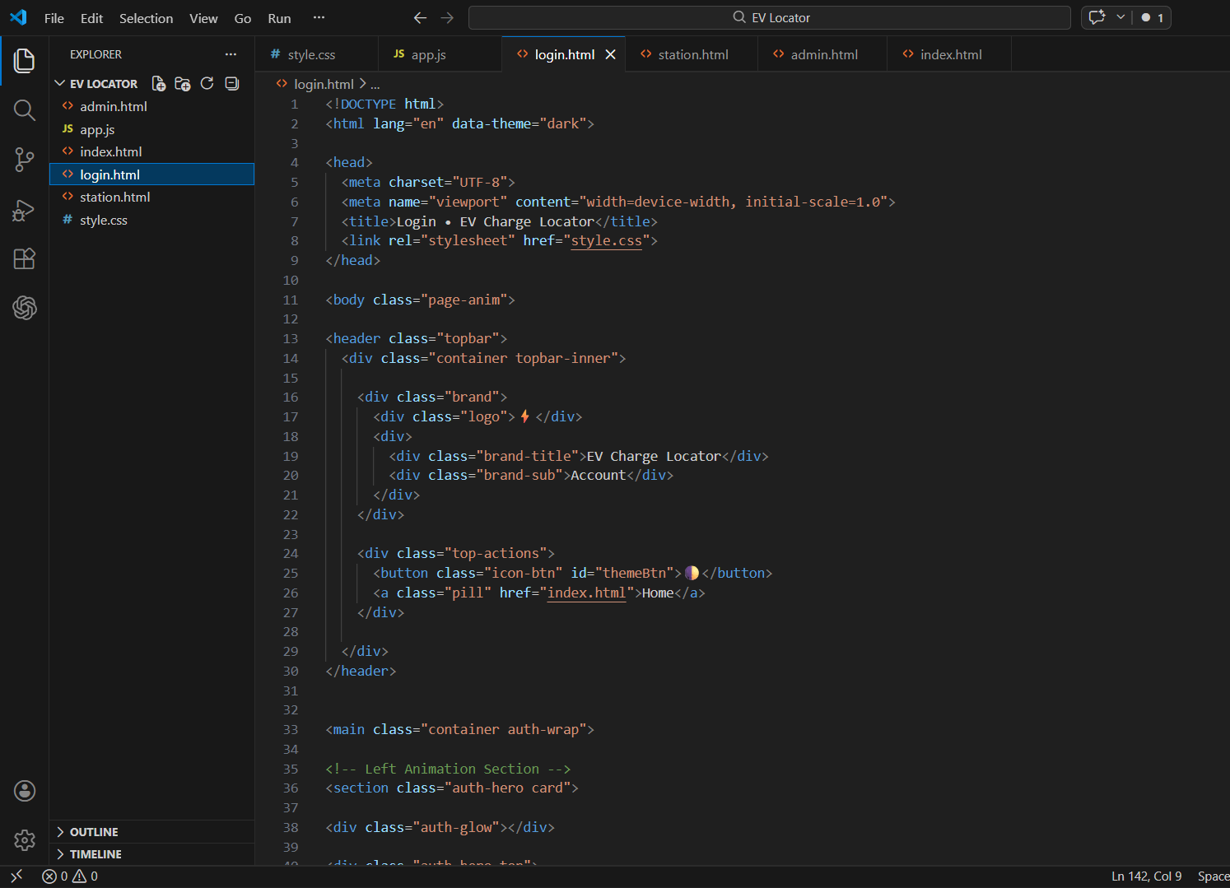
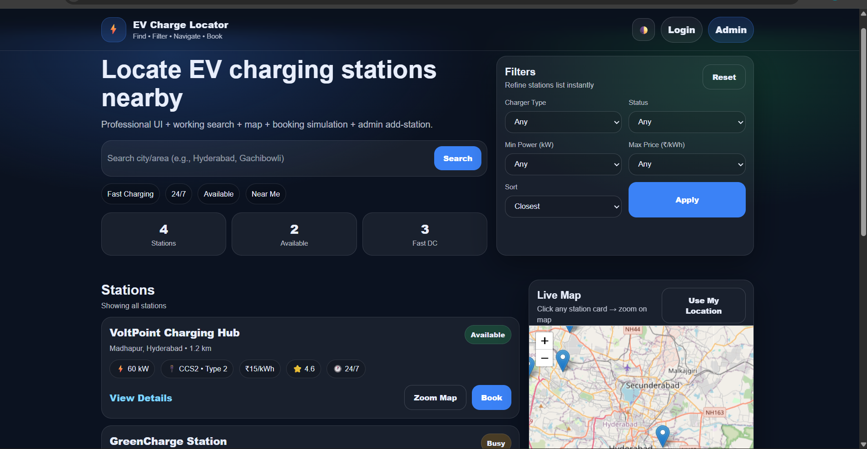
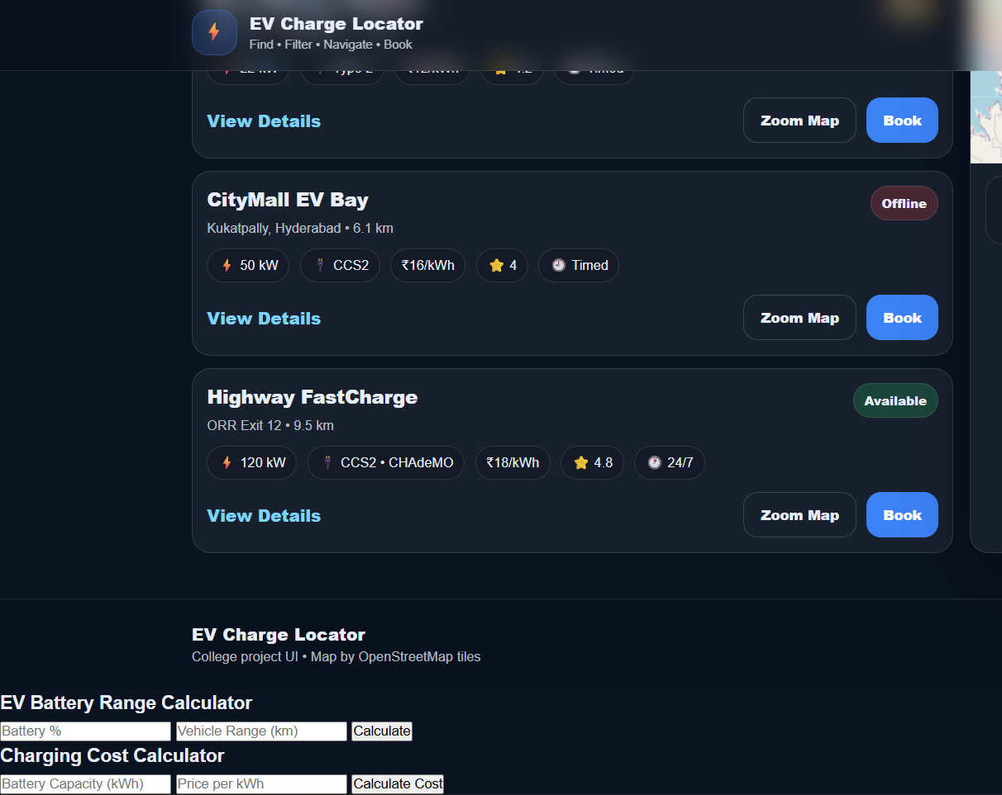
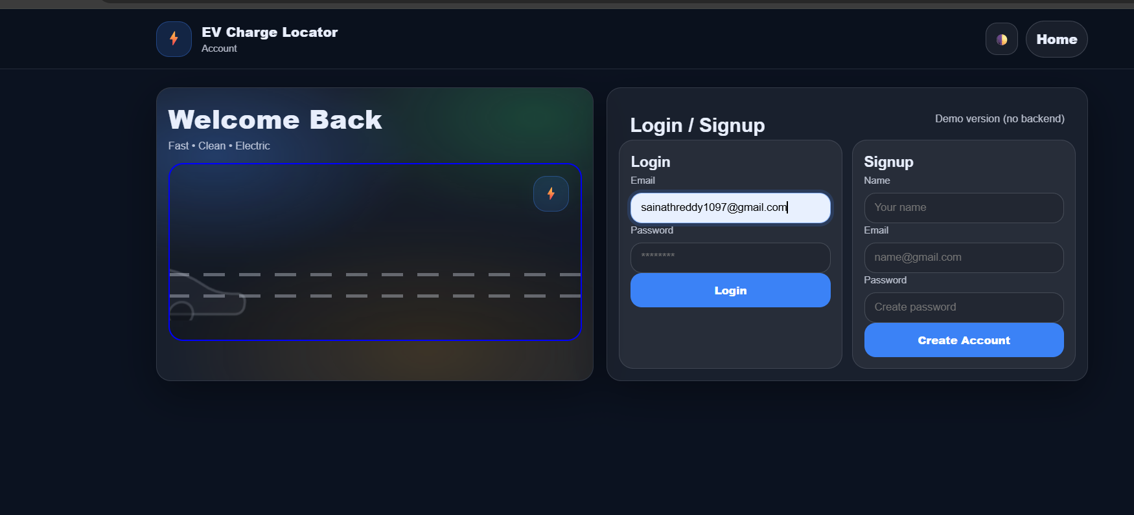
Screenshots for FWD & DSA

Slide 13
Conclusion
The EV Charging Station Locator System project provides a smart and efficient solution for helping electric vehicle users find nearby charging stations quickly. The system allows users to view station locations, check important details such as charging power, price, and availability, and filter stations based on their needs. Map visualization using Leaflet improves user experience by clearly displaying station locations.
By implementing search, filtering, and AI-based recommendation features, the system reduces the time and effort required for EV users to locate suitable charging stations. The project also demonstrates the practical use of web technologies such as HTML, CSS, JavaScript, and browser storage to build a functional real-world application.

Slide 14
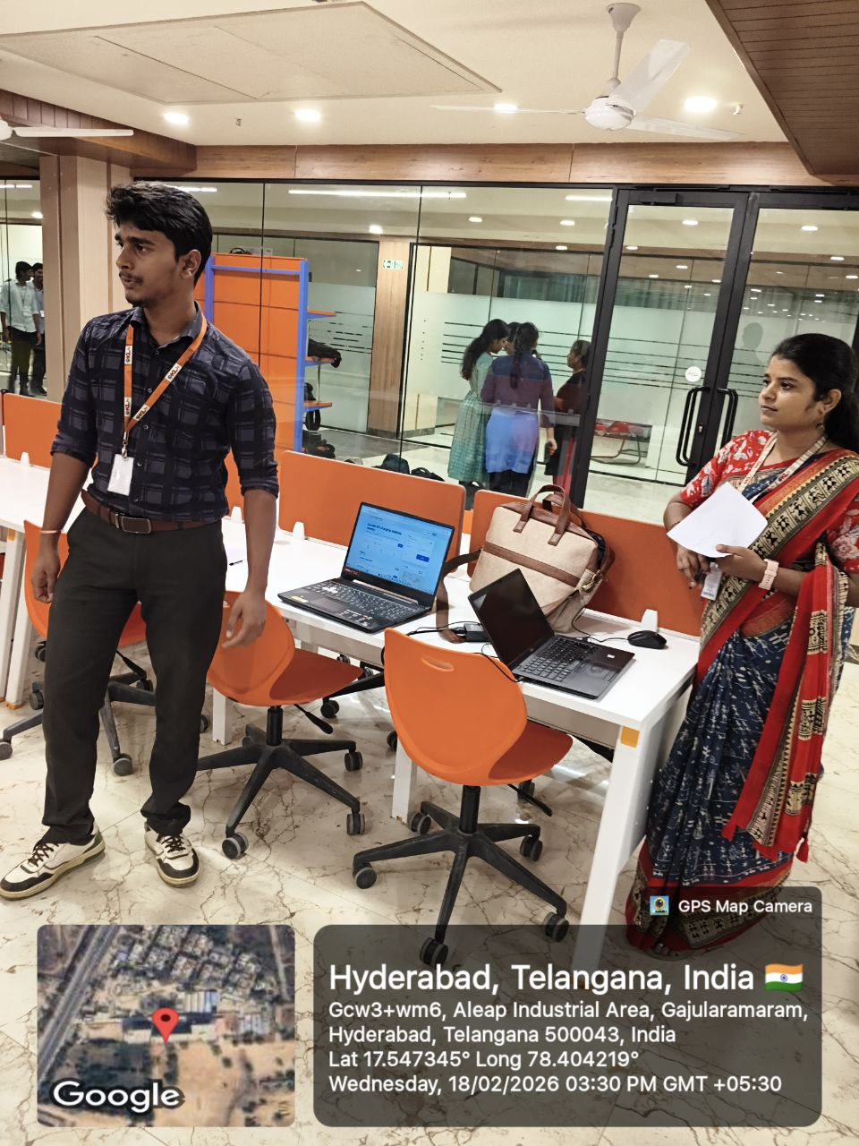


Geo- Tag Photos
Geo- Tag Photos
.
09-03-2026
173030211 Department of CSE
14

Slide 15
THANK YOU

